Slide 1
Consumer Education
Ethics
Definition- principles of what is right and wrong

Slide 2
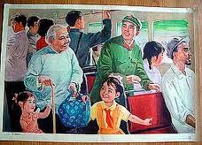
The grocery store
Public transportation
-don’t squeeze fruit
-don’t open boxes with food
don’t put your bags on the seat
Offer your seat to a pregnant woman, disabled person, or an older person

Slide 3
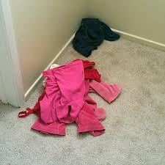
the hairdresser
The clothing store
Call 24 hours in advance to cancel the appointment
don’t leave clothes in a heap after you tried them on
don’ return for full refund clothes or shoes that you already wore.

Slide 4
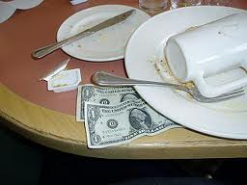
20% of $20=$ 20% of $15=$
The restaurant, school cafeteria
Snacking in the grocery store
Clean your table in a fast- food restaurant
Leave a tip in a sit-down restaurant – 15%-20%
Don’t eat food you haven’t paid for

Slide 5
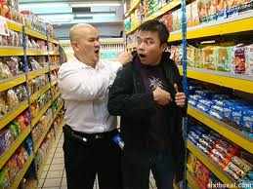
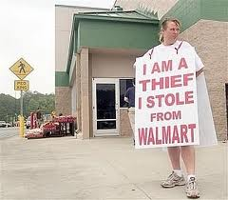
shoplifting
Stealing from the store-crime
Punishment- you get arrested

Slide 6
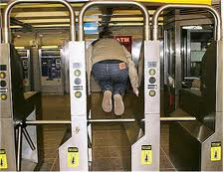
Price switching
Fare beating
Don’t put the lower price tag on the higher priced item
Don’t sneak into theaters, trains, or buses without paying

Slide 7
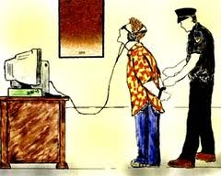
Using copyrighted material without permission
Internet
Essays and Information on line
Don’t download music, or movies from the Internet unless they are free
Cite the sources when you write an essay
Use quotation marks “___”
If you use the exact words of someone else.
Easybib.com

Slide 8
My Information on Line
Facebook
Cyber bullying
Be careful what you put on the Facebook- your future employers, colleges, and stockers are watching
Information never goes away
Don’t text, or e-mail messages that could hurt others

Slide 9
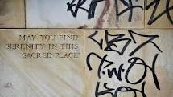
Vandalism (destroying other people’s property)
graffiti
Don’t spray paint graffiti on the walls
Result: higher taxes, higher crime

Slide 10
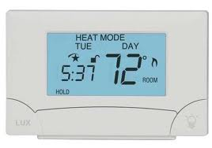
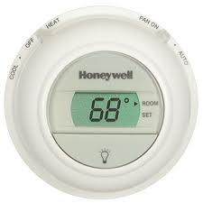
Conserve Energy
Heat and Air Conditioning
Use less water
Use less heat and air conditioning
-heat (winter) 68 ◦ F
-air conditioning (summer)-
73◦F
Wash clothes-warm/cold
Take quick showers instead of baths

Slide 11
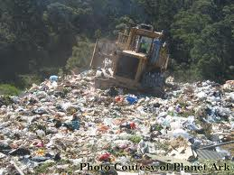
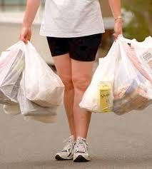
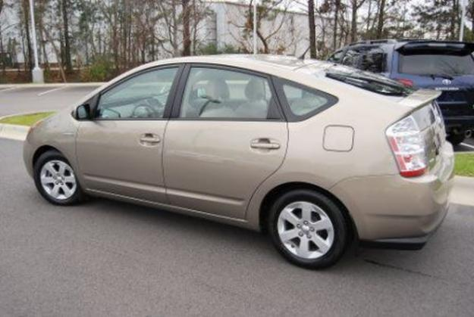
Use less gasoline
Use less plastic
Ride your bicycle
Walk
Buy small, high efficiency cars-high MPG (miles per gallon)-Toyotas, Hondas
-bring shopping bags to the store
-refill your water bottle

Slide 12
3 R’s Reduce, Reuse, Recycle
What kind of changes will I make in my life to reduce, reuse, and recycle natural resources?

