Slide 1
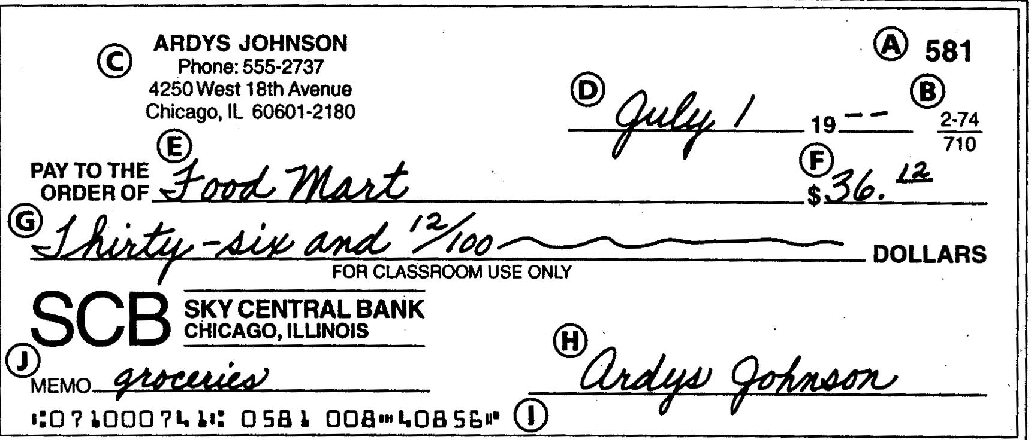
CHECKING ACCOUNT Parts of a Check
A. check Number B. ABA Number C. Maker's Preprinted Name and Address D. Date E. Payee F. Numeric Amount G. Written Amount H. Drawer or Maker I. Account Number J. Memo
routing number, identifies the bank

Slide 2
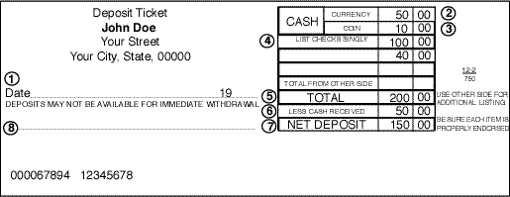
Deposit Slip

Slide 3
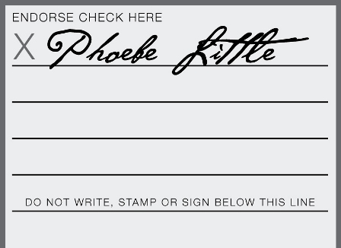
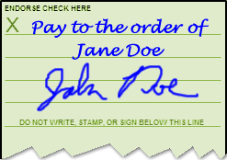
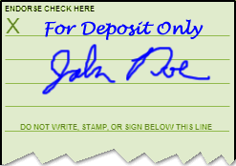
Endorsements (signing a check on the back before depositing it)
Blank
Special
Restrictive

Slide 4
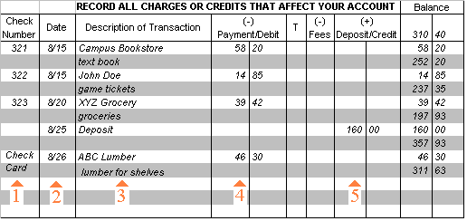
Checkbook Register

Slide 5
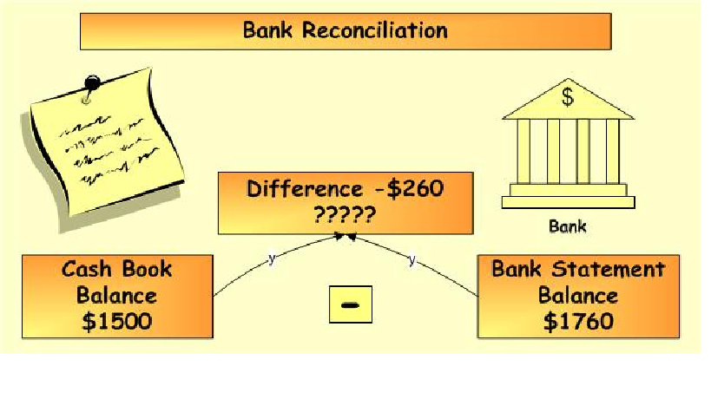
Balancing Your Checkbook

Slide 6
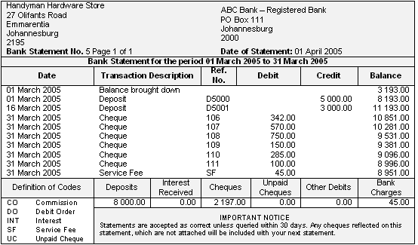
Bank Statement

Slide 7
QUESTIONS
What do you call a person to whom a check is made out to?
Where on the check is the account number?
Can you give your paycheck to your friend?
What type of endorsement will it have?
Do you add or subtract deposits made to your checking account?
Do you add or subtract checks you give to others?
What does bank reconciliation mean?

