Slide 1
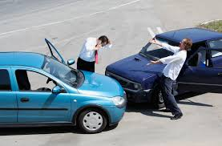
Auto Insurance
Mrs. Bruzan

Slide 2
Liability Insurance -Minimum Limits in Illinois
Who and what is covered?
The other driver and his car
Is it required by the state of Illinois?
Yes
What is 20/40/15?
20 means $20,000 bodily injury per person
40 means $40,000 bodily injury
per accident
15 means $15,000 property damage
TRY TO GET HIGHER LIMITS

Slide 3
Full Coverage
What does it cover?
The other driver, his car, and your car
What does comprehensive cover?
Theft, fire, fallen branch, vandalism
What does collision cover?
Any damage done to your car due to collision
What is a deductible?
Amount you pay for your car if your car is damaged or stolen.
Damage $5000
Deductible $500
Insurance will pay $4500

Slide 4
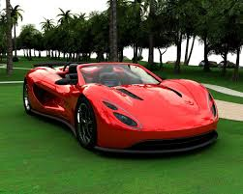
Premium (cost) depends on
Age- (younger drivers pay more)
Gender (males pay more than females)
Marital status (single pay more than married people)
City or suburbs (city pays more)
Driving record (3 years back-drivers with tickets and accidents pay more)
Type of car (sports and SUVs pay more)
Miles per year
Highest Premium
Under 25
Male
Single
City
Tickets and accidents
Sports Car
Over 15,000 miles per year

Slide 5
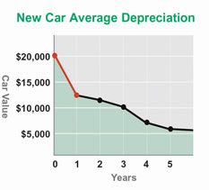
Liability or Full Coverage?
LIABILITY
Cars over seven years old
Cars depreciate-lose value
FULL COVERAGE
Cars newer than seven years
Financed cars-if you borrowed money from the bank

Slide 6
Discounts
Multiple cars
Good student – B Average up to 20% off

Slide 7
Can you drive your parents’ car if you are not listed on their insurance policy?
No
The insurance company does not have to pay if there is an accident?

Slide 8
What happens if you drive without auto insurance?
You will pay a fine from $500-$1000
Your license plates will be suspended until you get insurance.

Slide 9
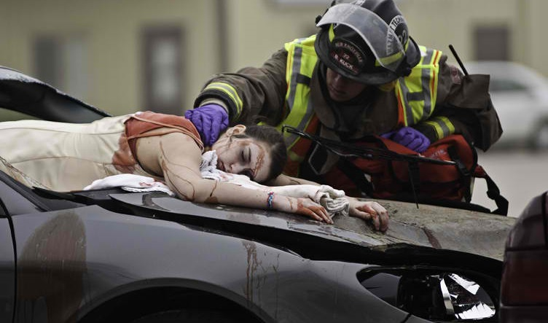
What happens if you drive under the influence of alcohol?
Illinois has zero tolerance
Your license can be suspended up to three years
lawyer’s fees-up to $10,000
First Drunk Driving Conviction: If alcohol level is above 00.00% but below .08% - 3-month license suspension.
If more than .08% imprisonment up to 1 year

